Slide 1

CATARACT CLASSIFICATION
Y.PAVAN SAI
http://aiclub.world

Slide 2
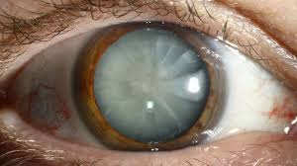
CATARACT CLASSIFICATION
A model used to predict whether the cataract is present or not for a particular person.
This can be classified into two types either mature or the immature.

Slide 3
DATASET
Number of samples : 410
Number of labels : 02
Problem type: Classification
Dataset Link : https://www.kaggle.com/datasets/akshayramakrishnan28/cataract-classification-dataset

Slide 4
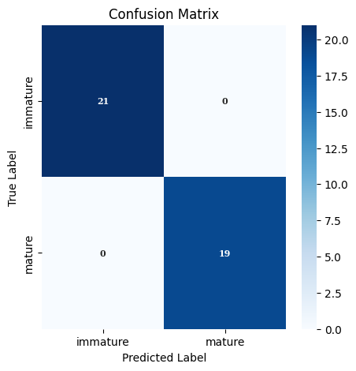
CONFUSION MATRIX
From both the neural networks taken, the MobileNetV2 has performed well with less loss as well as the good accuracy and a perfect confusion matrix

Slide 5
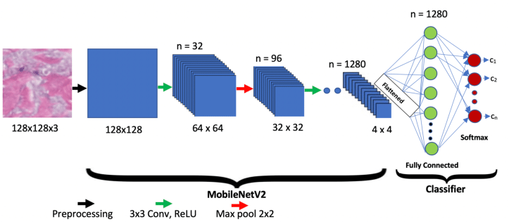
MobileNetV2

Slide 6
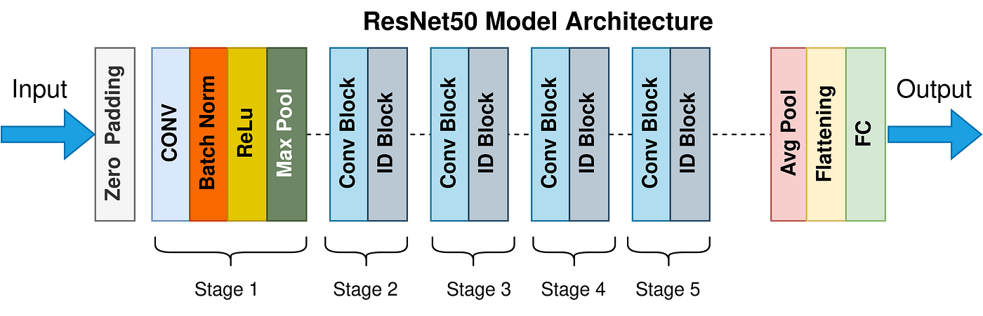
ResNet50

Slide 7
HYPER PARAMETER TUNING
The parameters that are being tuned are epoch and the learning rate
Epoch are taken as 10,20 and 30 whereas the learning rate ranges from 0.01-0.00001. The batch size can be varied as 16,32 and 64
The parameter tuning plays an important role in selecting the best model

Slide 8
THANKYOU

